Slide 1
Create Multiple Angular Apps in One Project

Slide 2

Module Overview
Advantages
Create the Empty Workspace
Add a new Project to Workspace
Run the App
Add Another Project to the workspace
Run the App
Building the App for Production
Folder Structure
projects folder
dist folder
Angular.json
Summary

Slide 3
Advantages
There are several advantages of having Multiple Angular Apps in One Project.
One is you do not have to run the time consuming npm install for every app.
The node_modules folder is shared with all the other apps saving disk space.
All the apps can be updated to the next version easily.
A single source-control repository (such as git).

Slide 4

Create the Empty Workspace

Slide 5

Add a new Project to Workspace

Slide 6
Add a new Project to Workspace
If you use the ng new inside the workspace, it will throw the following error.
The new command requires to be run outside of a project, but a project definition was found at “D:\MultipleApps\angular.json”

Slide 7
Run the App
There are three ways in which you can run the app.
Use the ng serve gettingStarted
Use the --project flag ng serve --project="gettingStarted"
Open the angular.json and locate the defaultProject and change the name of the project to gettingStarted and run ng serve

Slide 8

Add Another Project to the workspace

Slide 9

Run the App

Slide 10

Building the App for Production

Slide 11
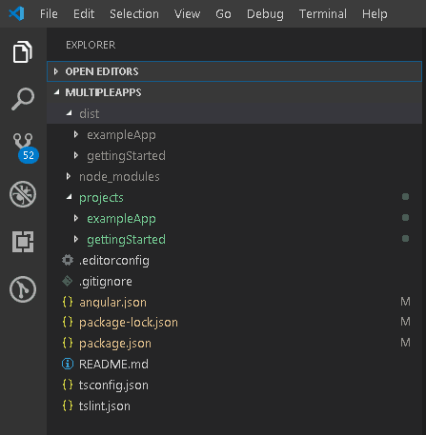
Folder Structure

Slide 12
projects folder
The src folder is gone.
Instead, we have a projects folder.
Each app we create gets its own folder under the projects folder.

Slide 13
dist folder
The dist folder now has a folder for each new app.

Slide 14
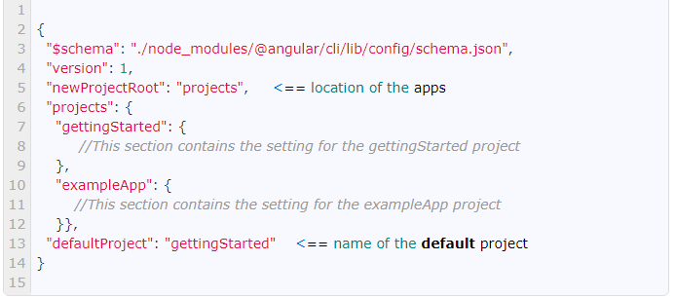
Angular.json

Slide 15
Summary
In this module, we learned how to organize multiple apps in one single workspace/Project in Angular.

